Slide 1
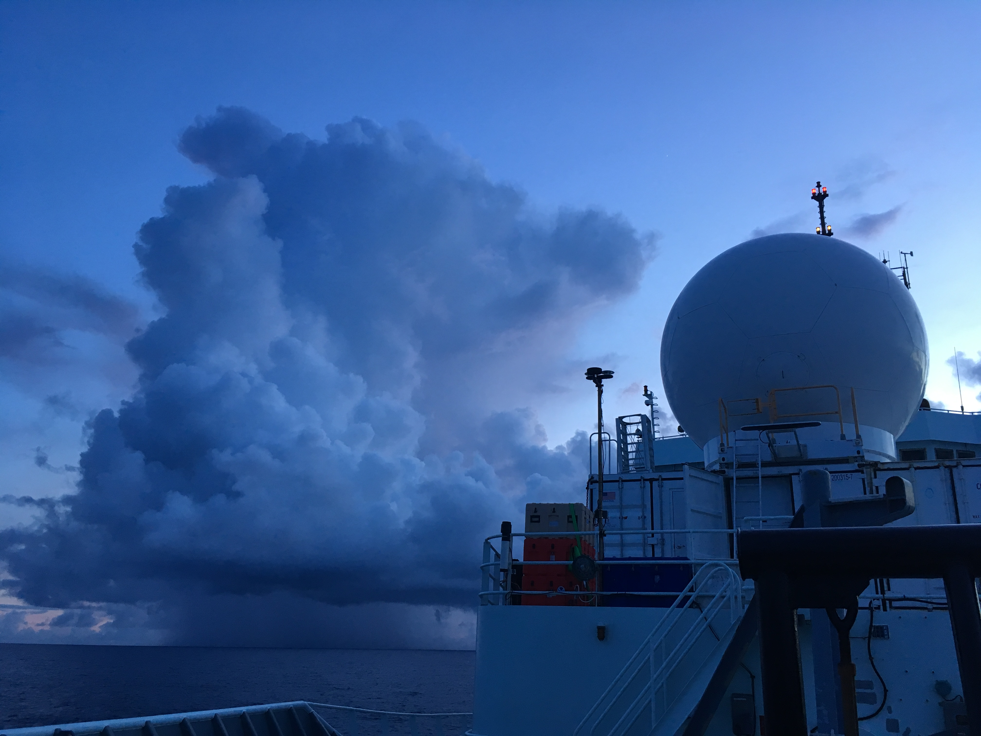
Observations of Convection Obtained over the West Pacific during PISTON* 2018
Scott W. Powell
Naval Postgraduate School, Monterey, CA
28 November 2018
*PISTON is funded by the Office of Naval Research. Some of the instrumentation on board was funded by NOAA. Thanks to the R/V Mirai for their collaboration during the dual-Doppler measurement period. Author partly funded by NOAA C&GC fellowship, sponsored by CPAESS at UCAR, and NPS Research Initiation Program funds.

Slide 2
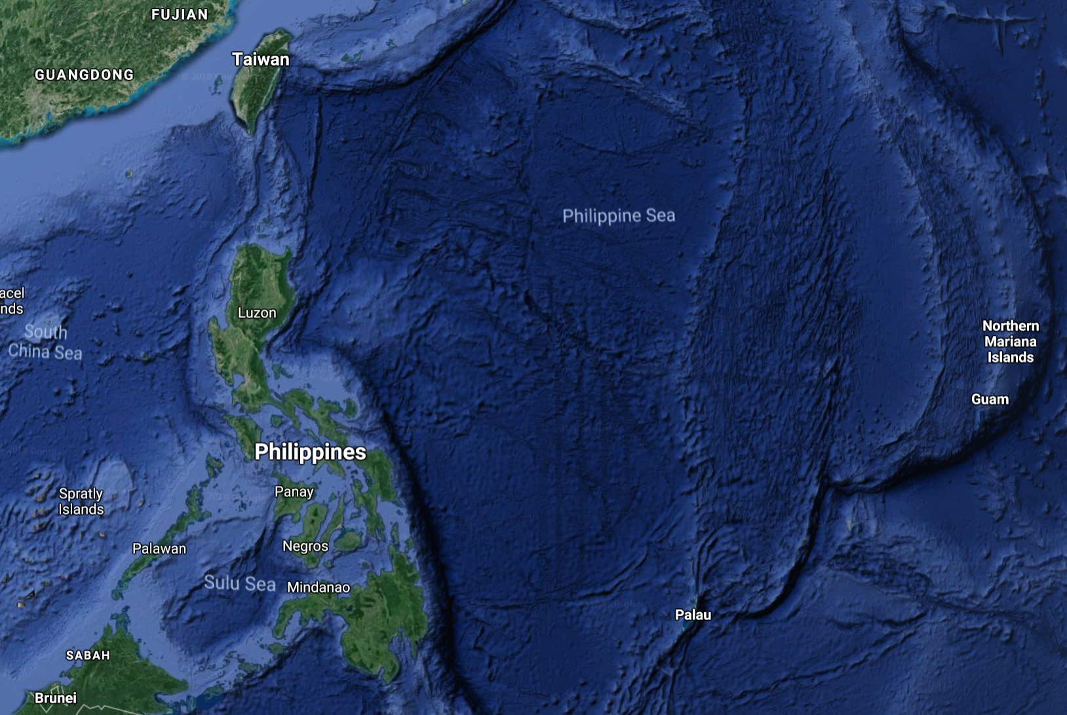

Slide 3
Palau Ridge (~134.5°E)

Slide 4
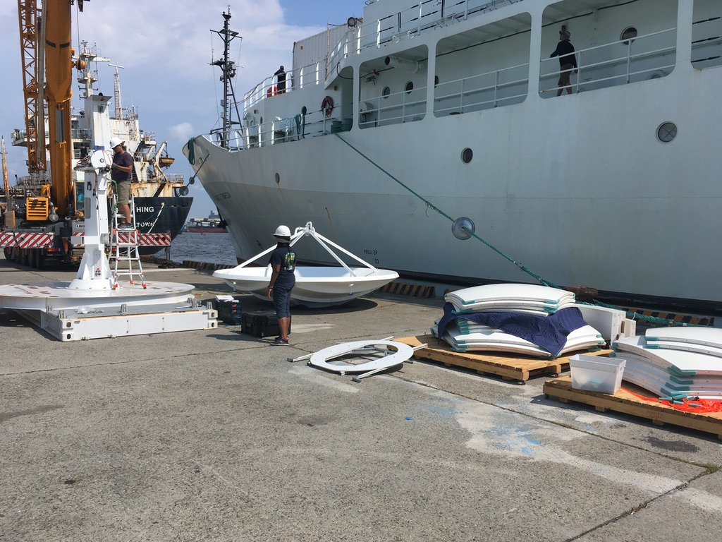

Slide 5
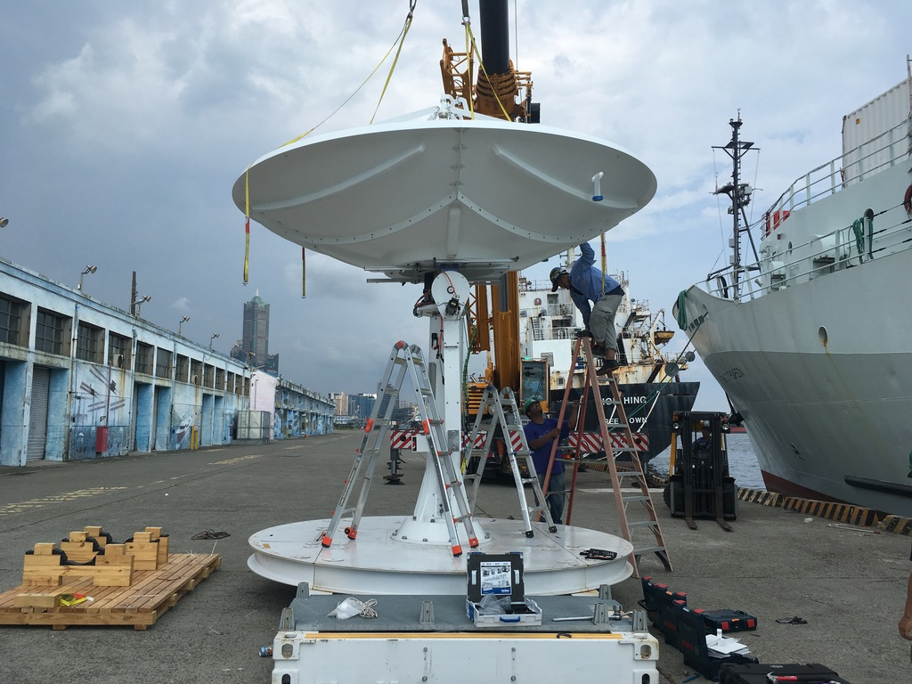

Slide 6
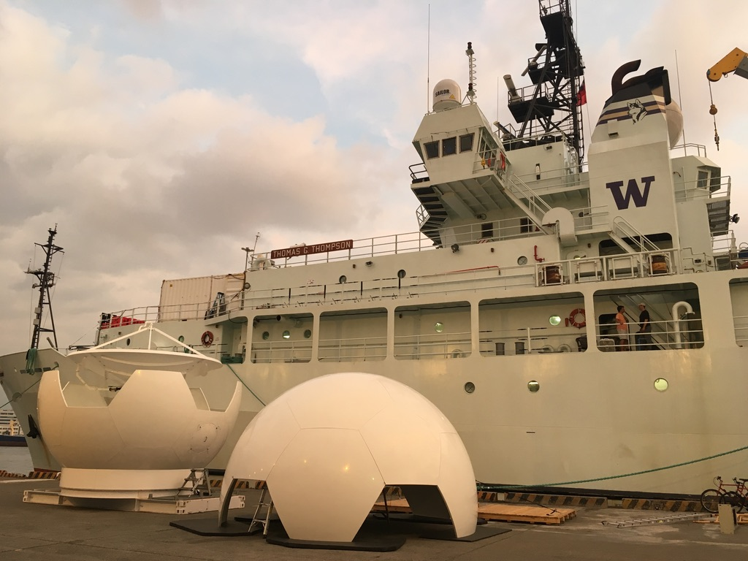

Slide 7
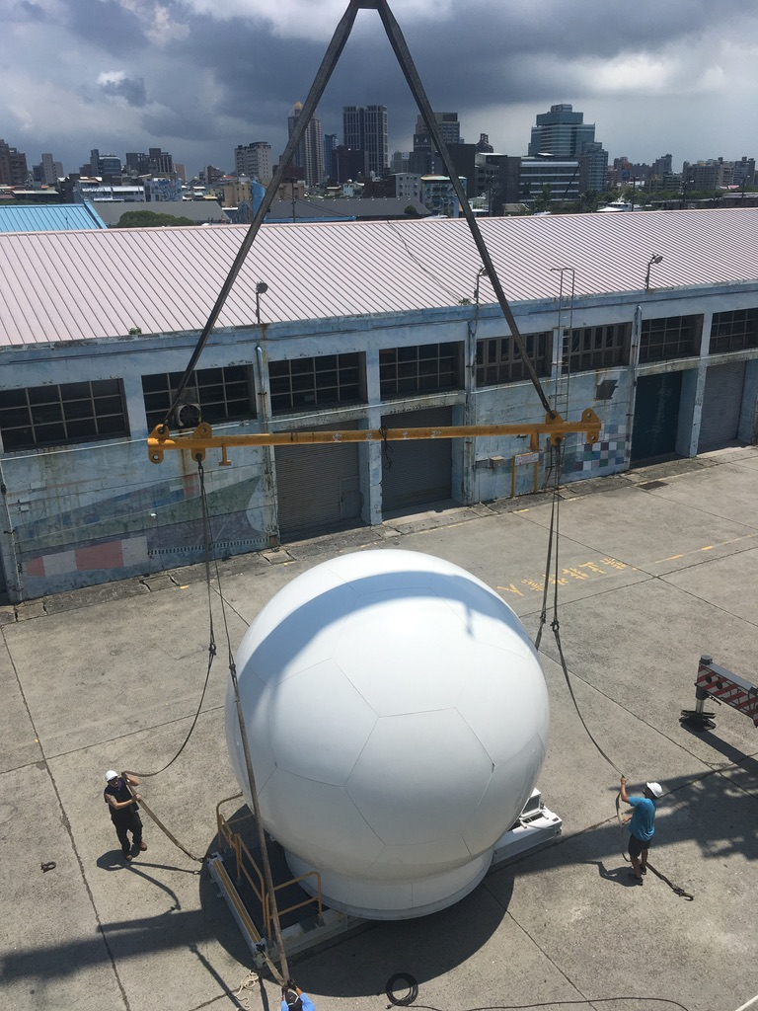

Slide 8
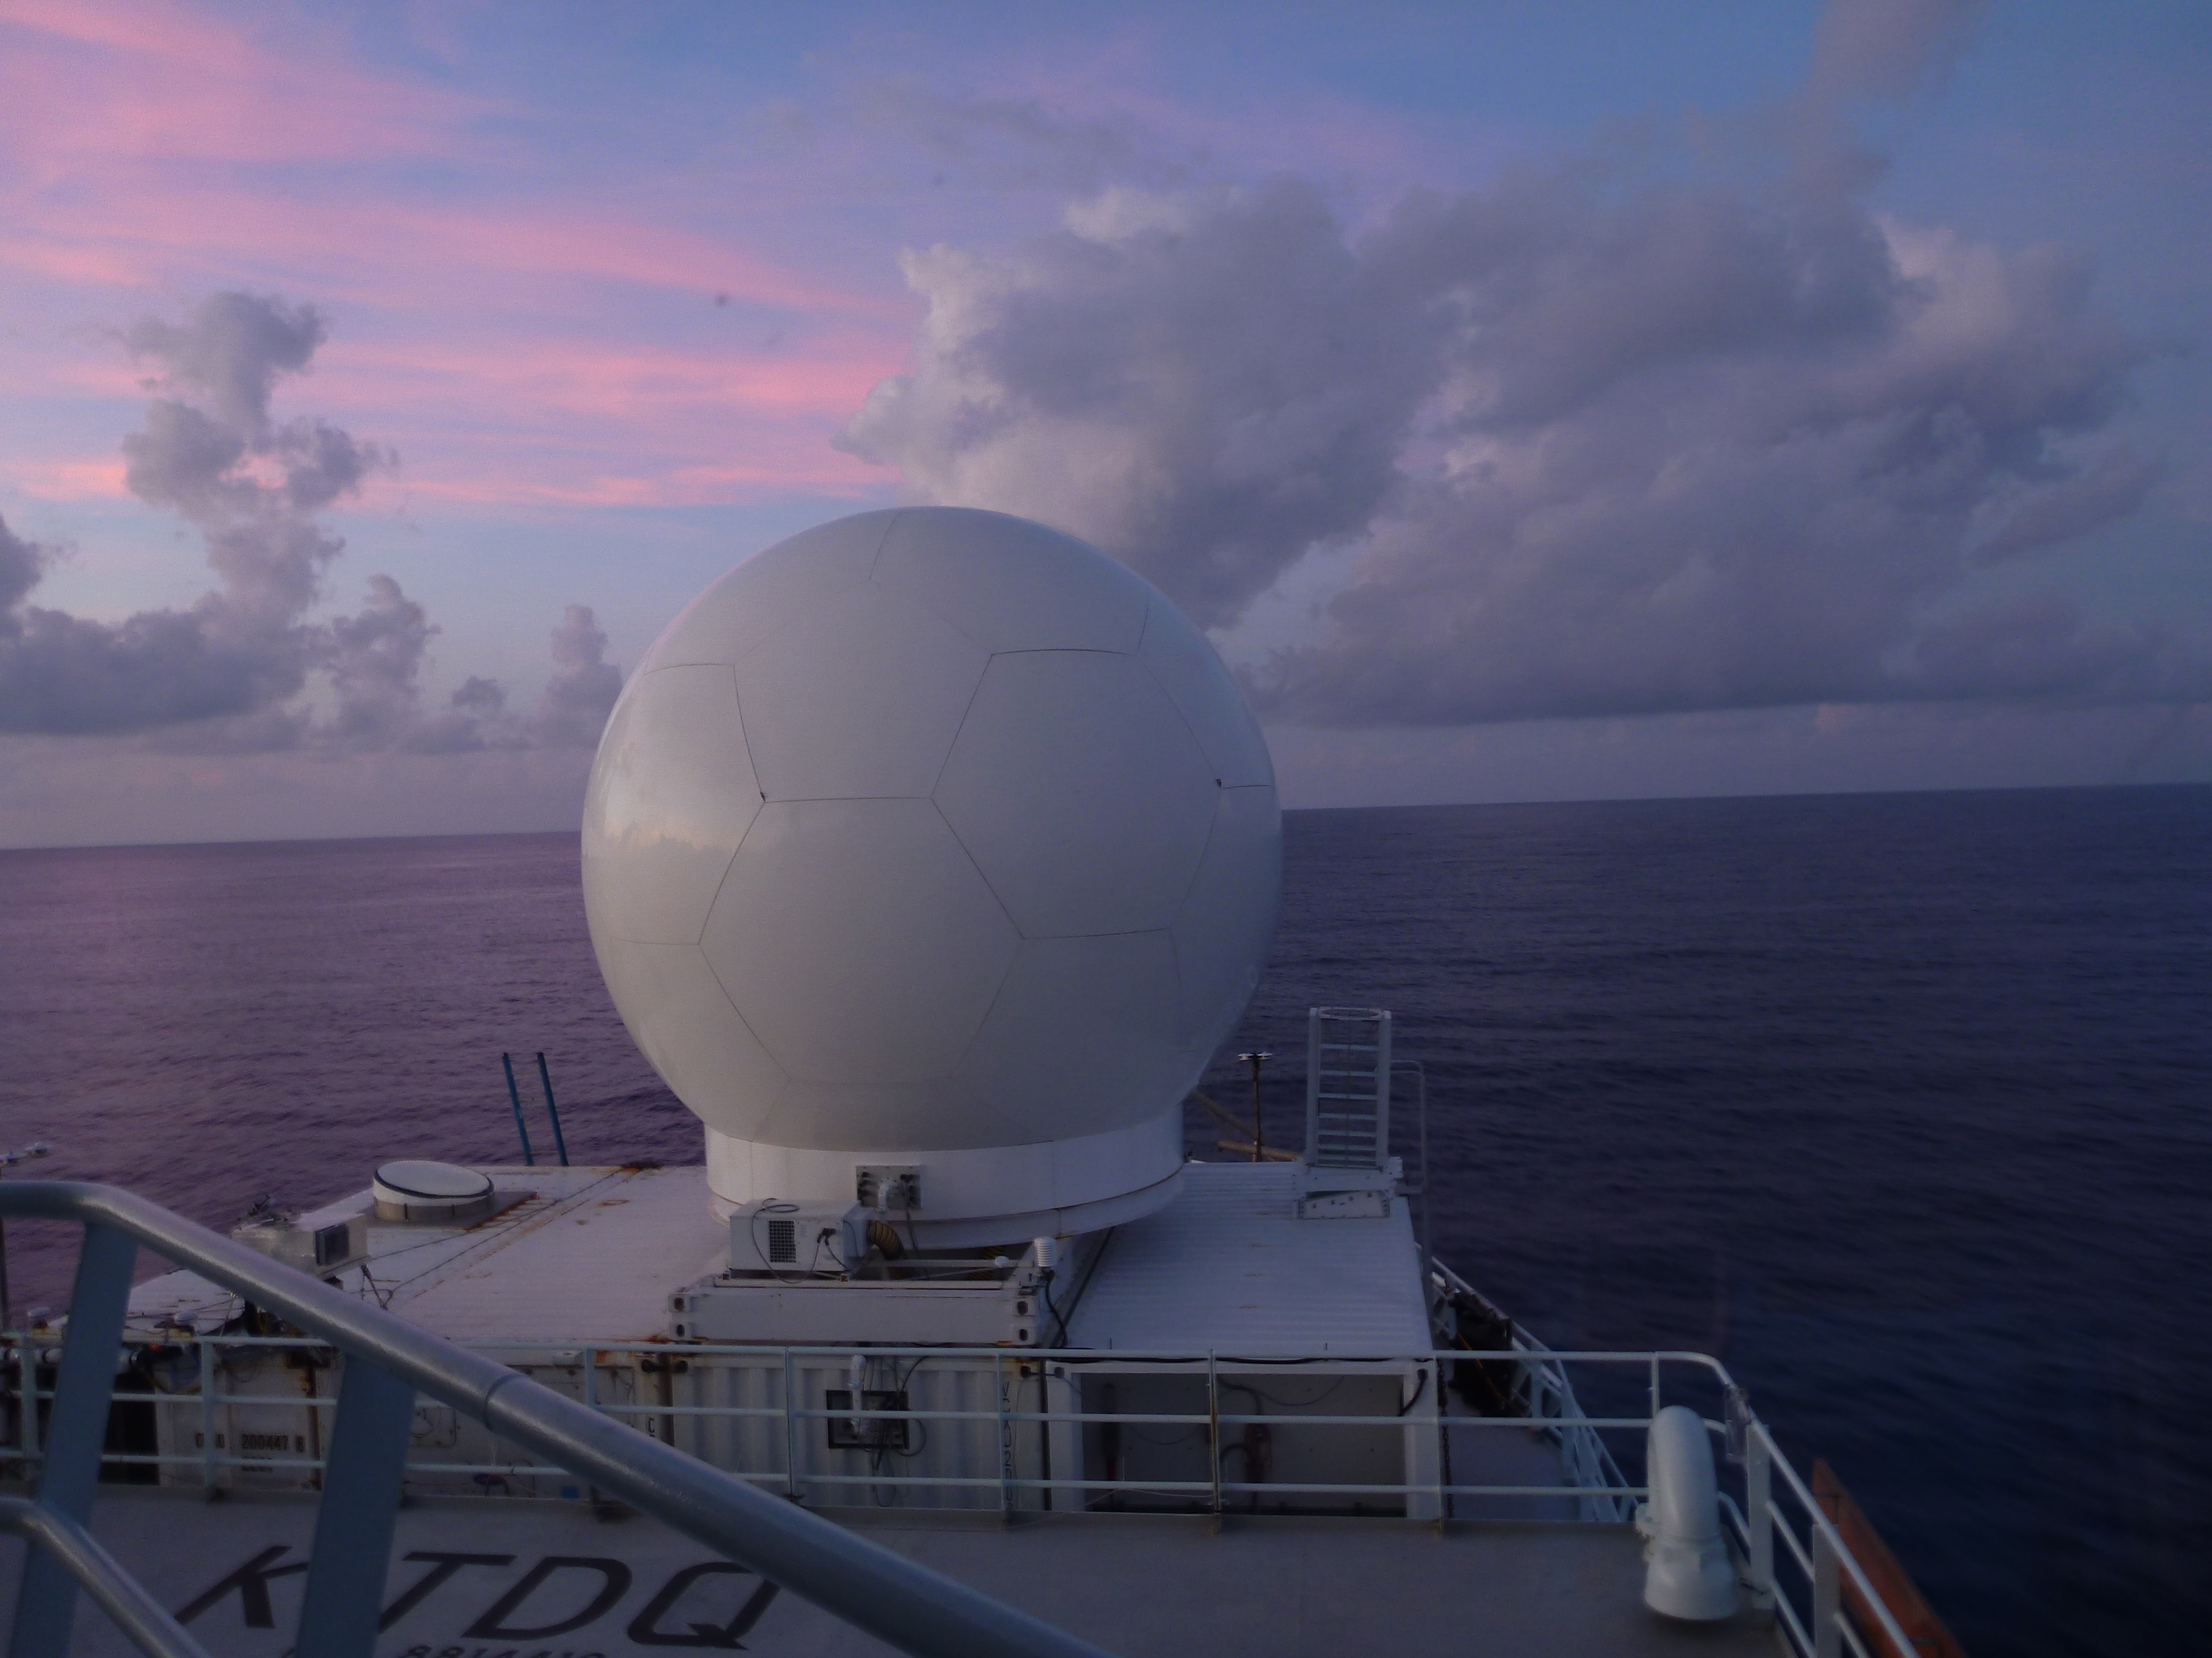

Slide 9
Ocean:
- Surf Otter (upper 10 m)
- Chameleon (below 10 m to about 300 m)
- CTDs (Conductivity, Temperature, Depth) (2000 m?)
- Underway CTDs (uCTDs)
- On board ship measurements: SST, surface current, salinity
- Moorings along Palau Ridge (during Leg 2)
Atmosphere:
- 8x daily soundings
- SEA-POL C-band precipitation radar
- W-band zenith pointing radar (lowest 5 km)
- NOAA Doppler lidar
- HSRL
- NOAA instruments (temperature, wind, humidity) on bow mast
- Rain gauges + optical disdrometer

Slide 10
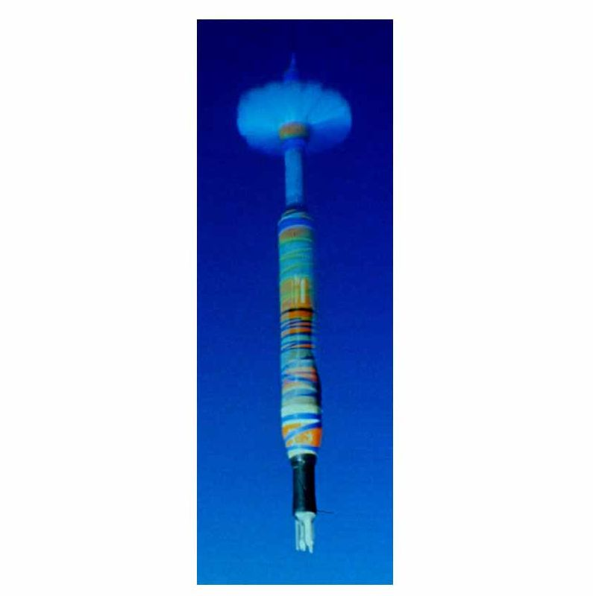
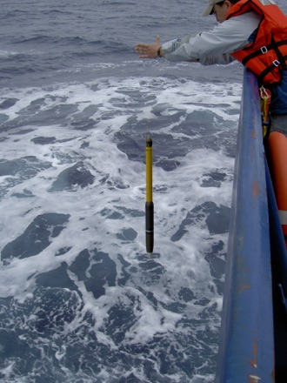
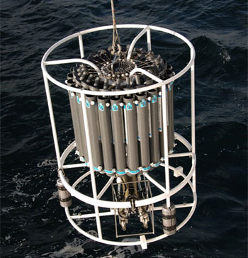
Underway CTD (uCTD)
Chameleon
CTD

Slide 11
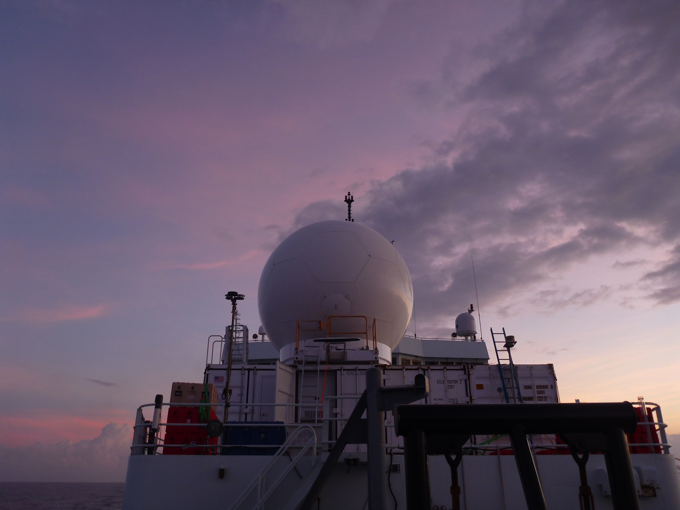

Slide 12
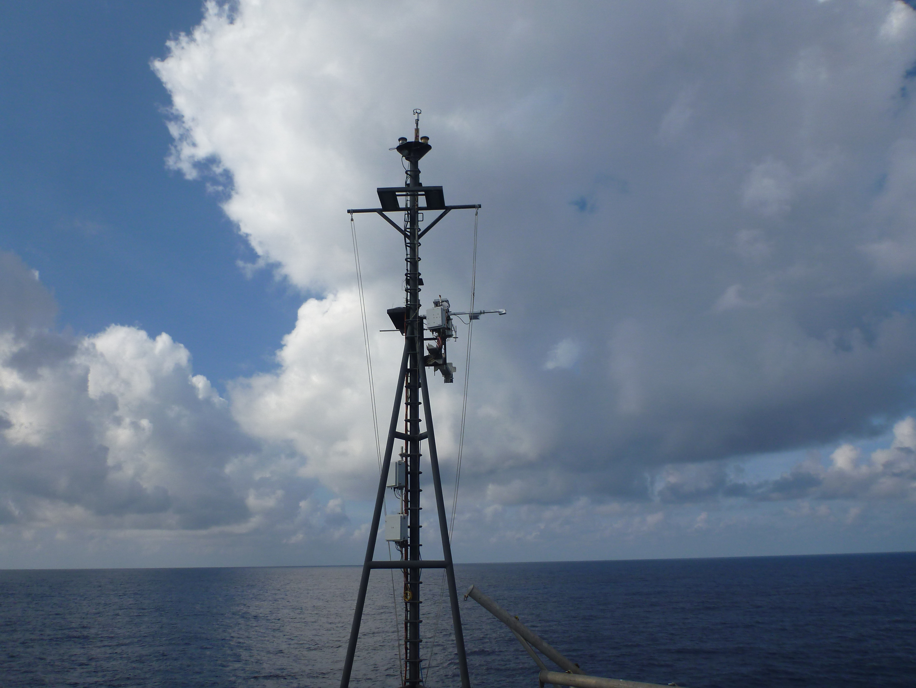
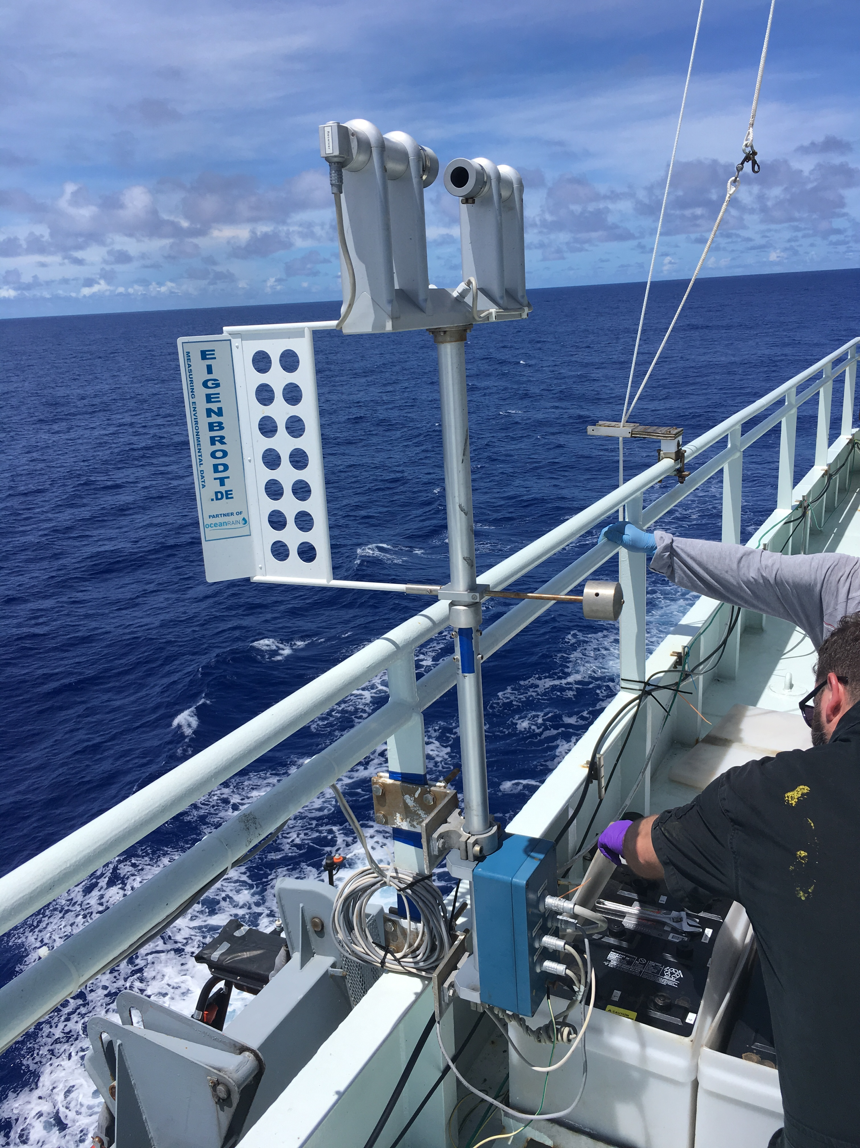

Slide 13
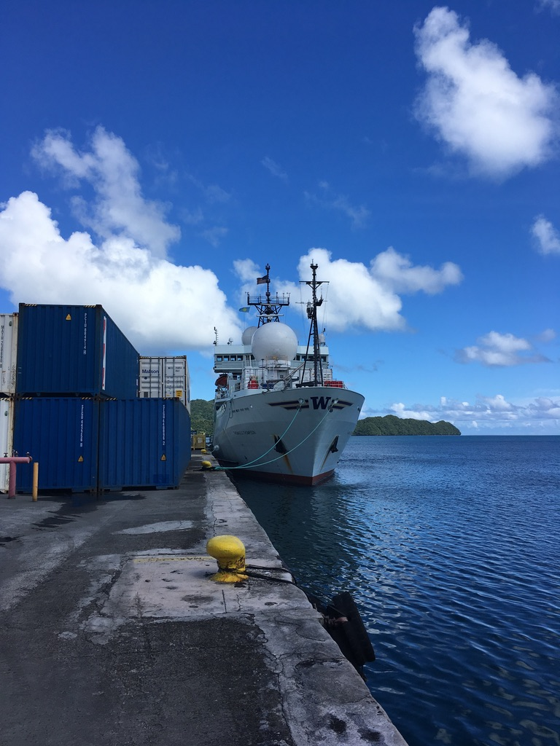

Slide 14
Large-Scale: The BSISO + Easterly Waves + ENSO + ???

Slide 15
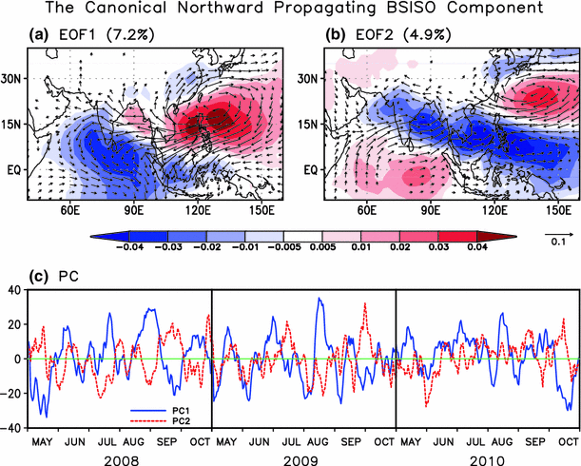
Lee et al. (2013)

Slide 16
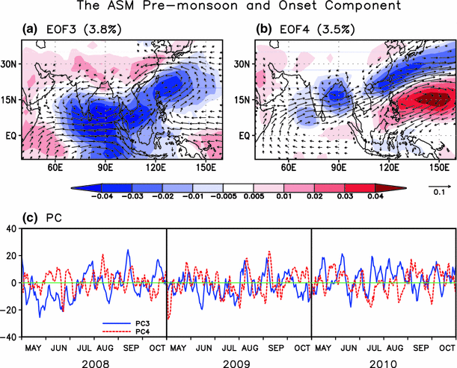
Lee et al. (2013)

Slide 17
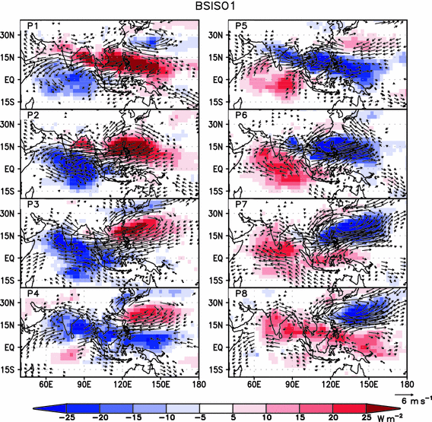
Lee et al. (2013)

Slide 18
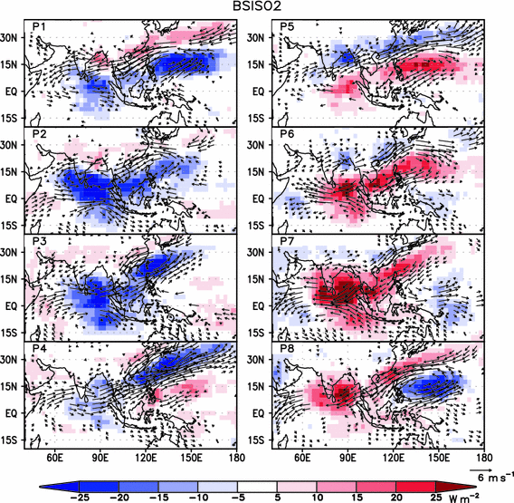
Lee et al. (2013)

Slide 19
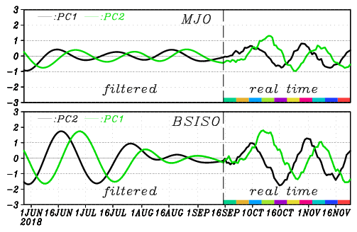

Slide 20
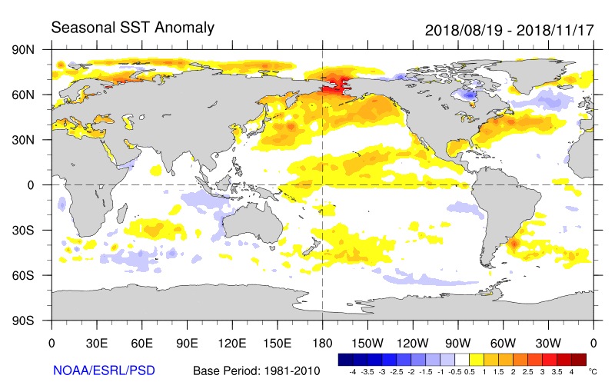

Slide 21
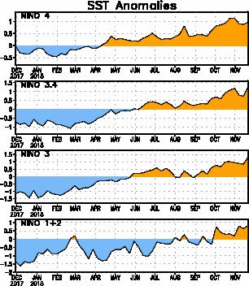

Slide 22
Data

Slide 23
u′

Slide 24
Thompson (approximately)
Mactan
Yap
Palau

Slide 25
u′

Slide 26
v′

Slide 27
RH′

Slide 28
Cimarron
Unnamed
Jebi
Mangkhut
Trami
Kong-rey
-10 to 10 m/s
20 dBZ echotop
u′
-10 to 10 m/s
v′
Blue is positive
RH′
-30 to 30%

Slide 29
Relative Humidity
Cimarron
Unnamed
Jebi
Mangkhut
Trami
Kong-rey

Slide 30
SEA-POL-derived domain-averaged rain rate
Jebi + unnamed low
Unnamed low
Mangkhut
Kong-rey
Trami
Cimarron

Slide 31
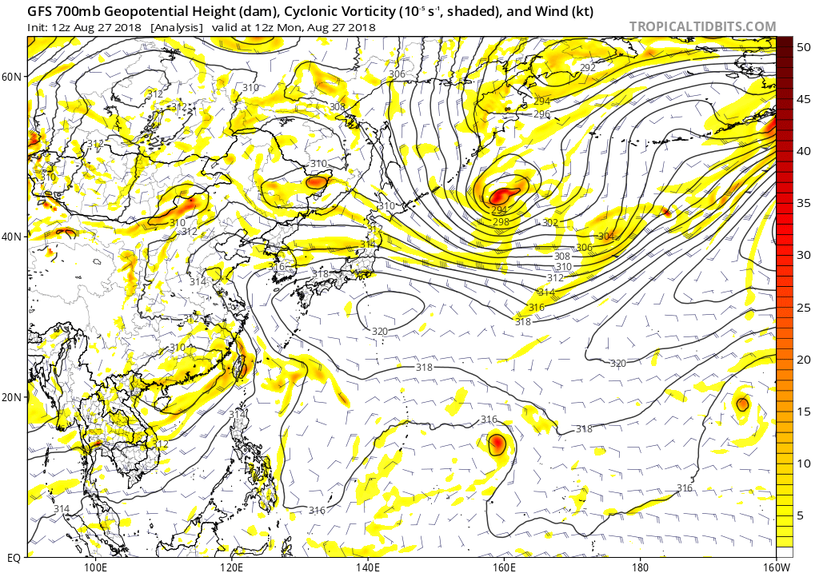
Suppressed: Aug. 27

Slide 32
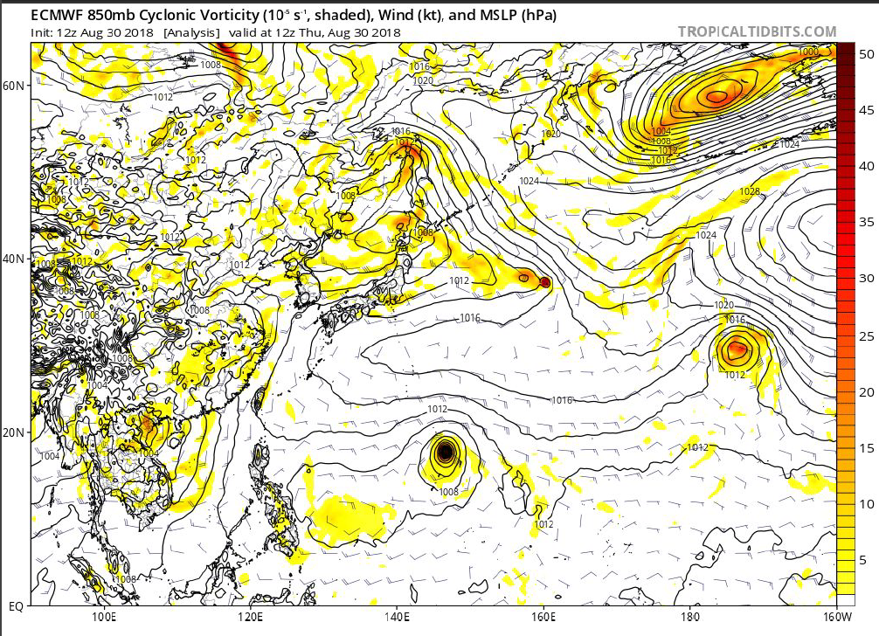
Suppressed: Aug. 30

Slide 33
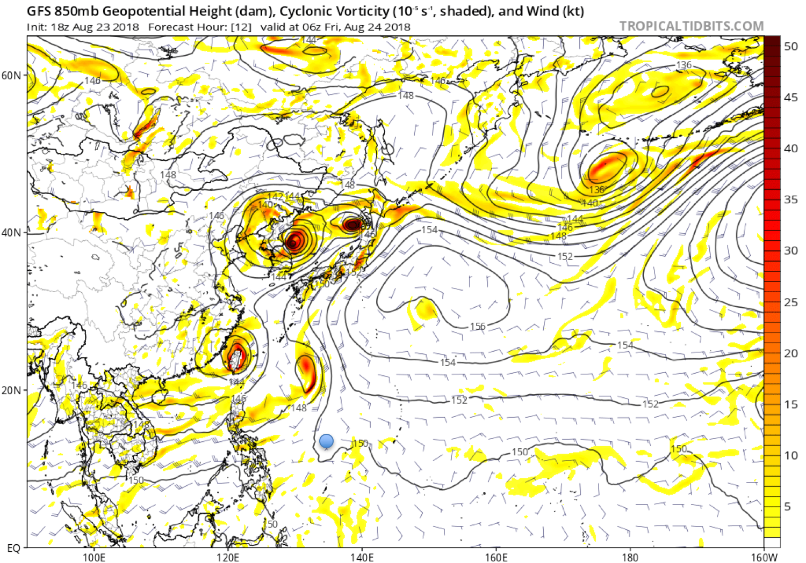
Active: Aug. 24

Slide 34
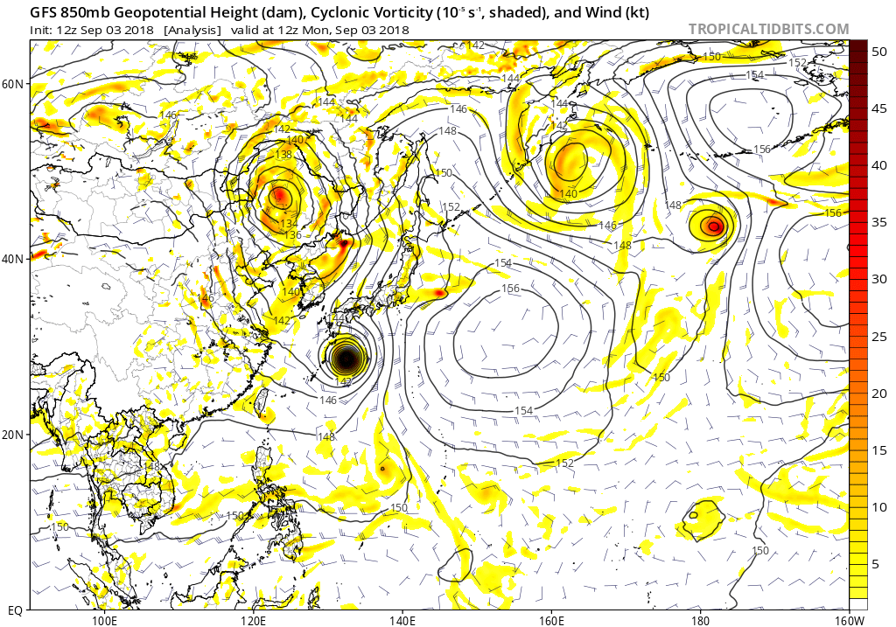
Active: Sept. 3

Slide 35
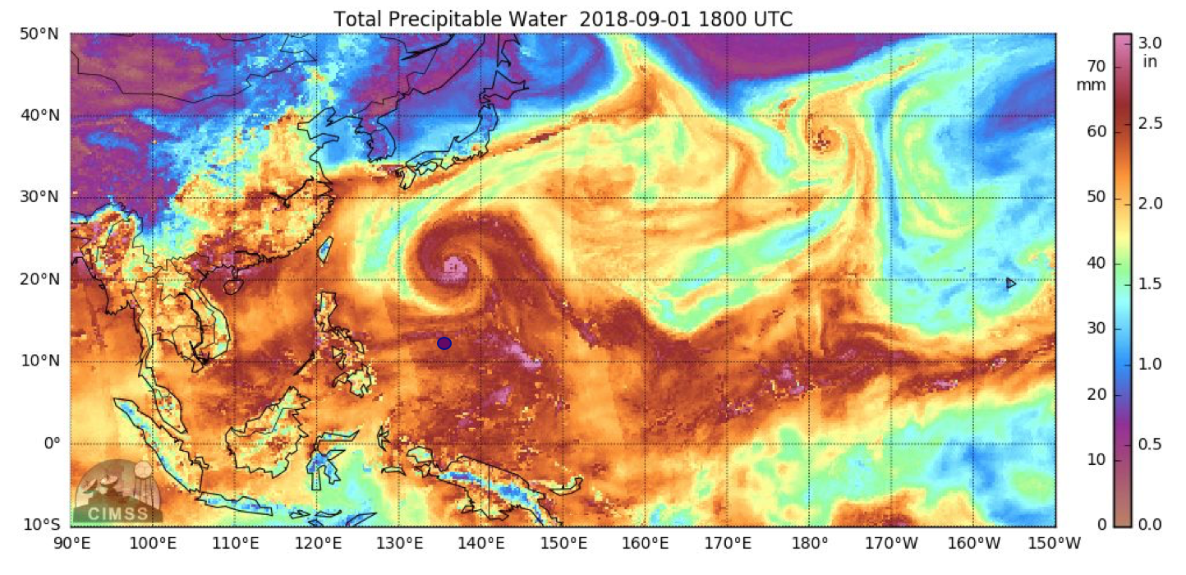

Slide 36
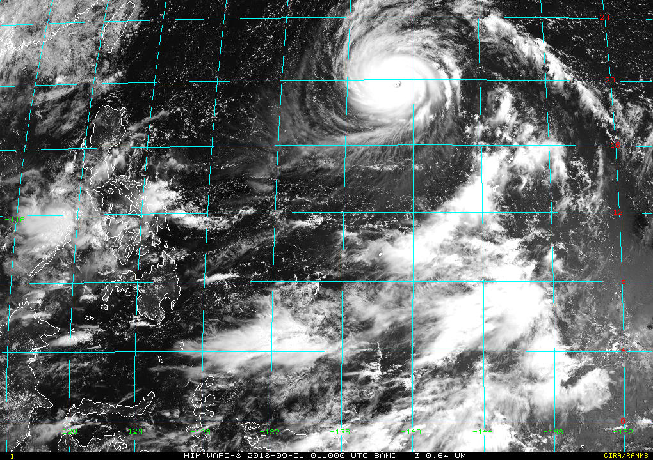

Slide 37
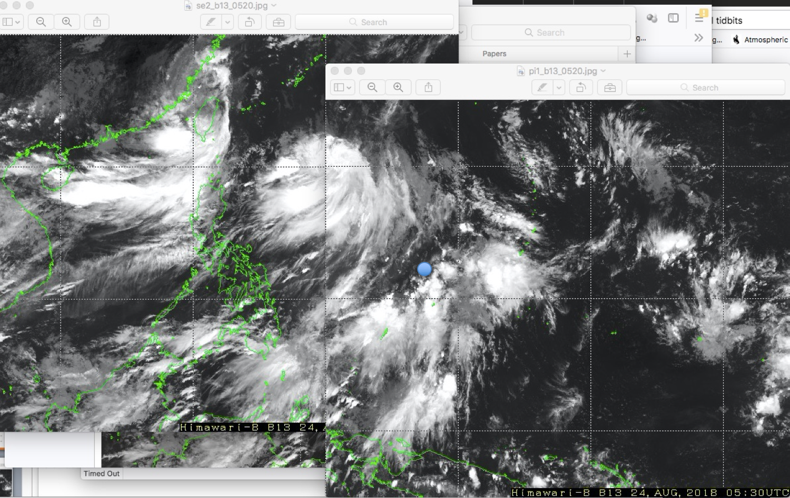

Slide 38
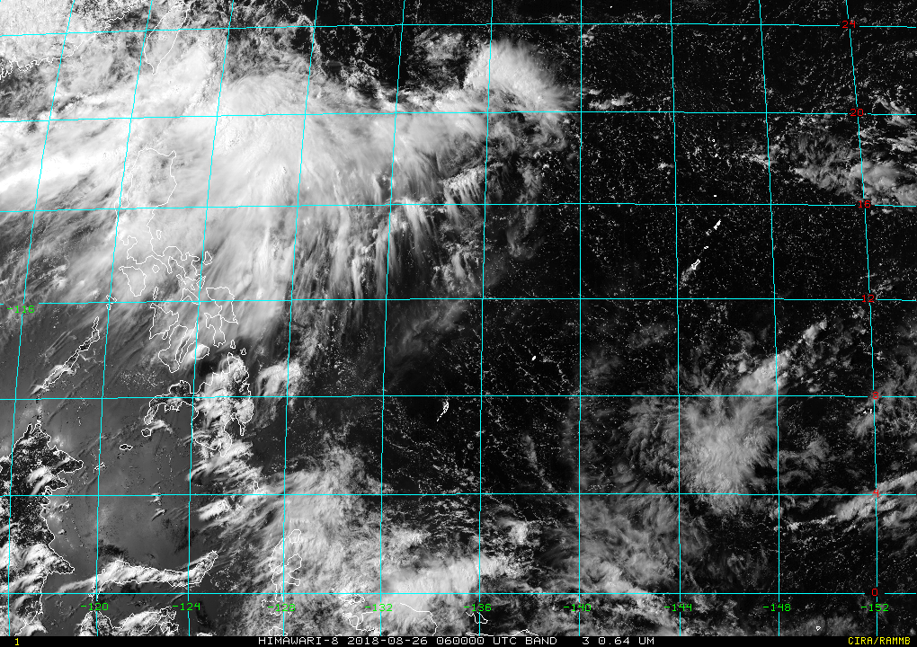

Slide 39
Aug. 21–Sept. 9
Sept. 14–Oct. 11
Aug. 1–Nov. 25

Slide 40
Not- rainy days
Rainy days

Slide 41
Hovmöller of OLR anomalies 10°N–20°N

Slide 42
Hovmöller of OLR anomalies 10°N–20°N
Cruise 1
Cruise 2

Slide 43
Precipitation vs. Relative Humidity

Slide 44
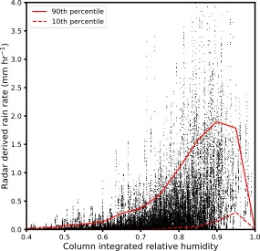
If precipitation is so dependent on environmental moisture, why does it sometimes not rain when the atmosphere is very moist?
PISTON
DYNAMO and Kwajalein

Slide 45
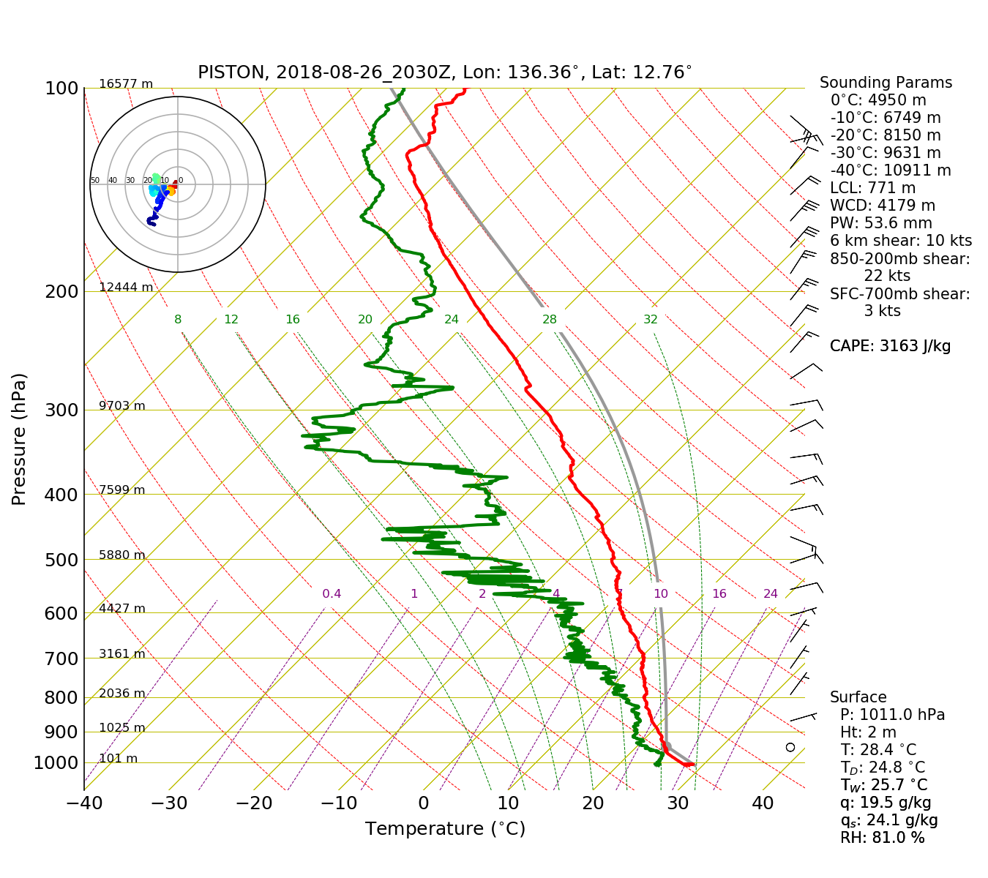

Slide 47
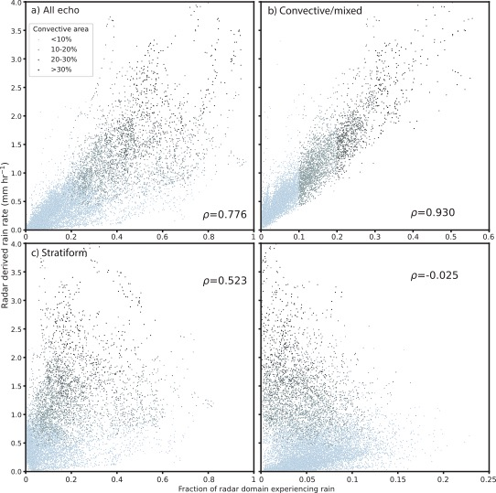

Slide 48
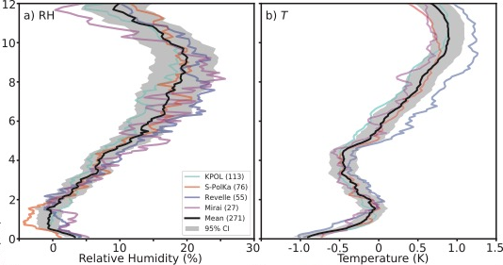
DYNAMO and Kwajalein
PISTON

Slide 49
Cold Pools and Aerosols

Slide 50
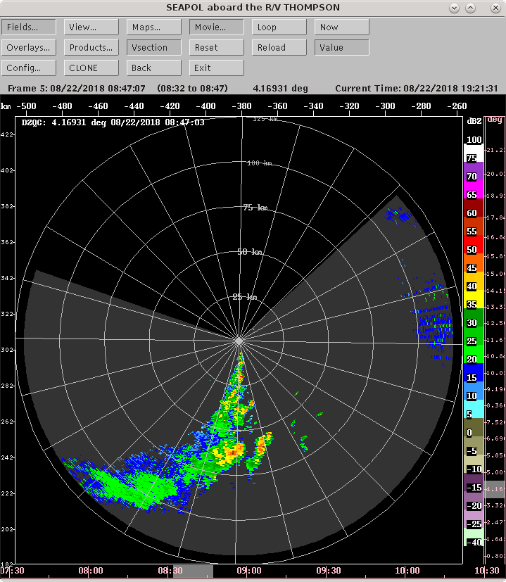

Slide 51
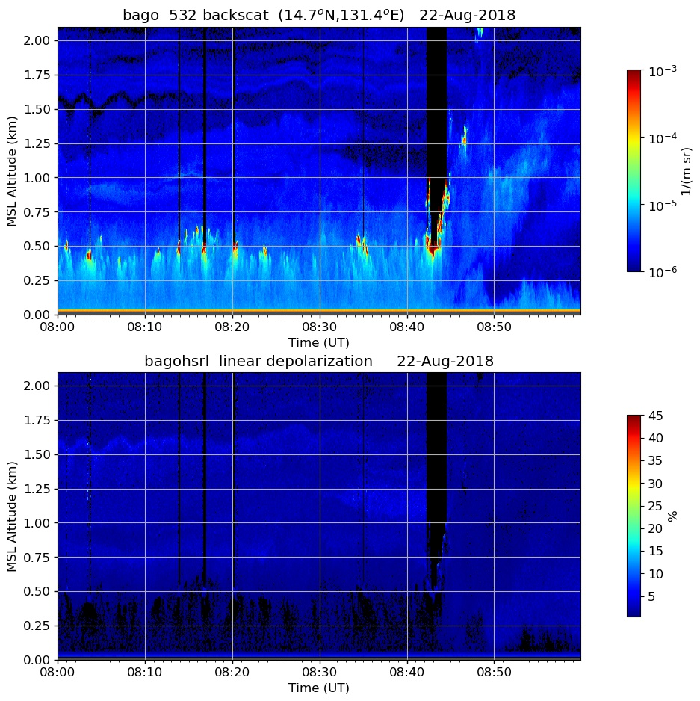

Slide 52
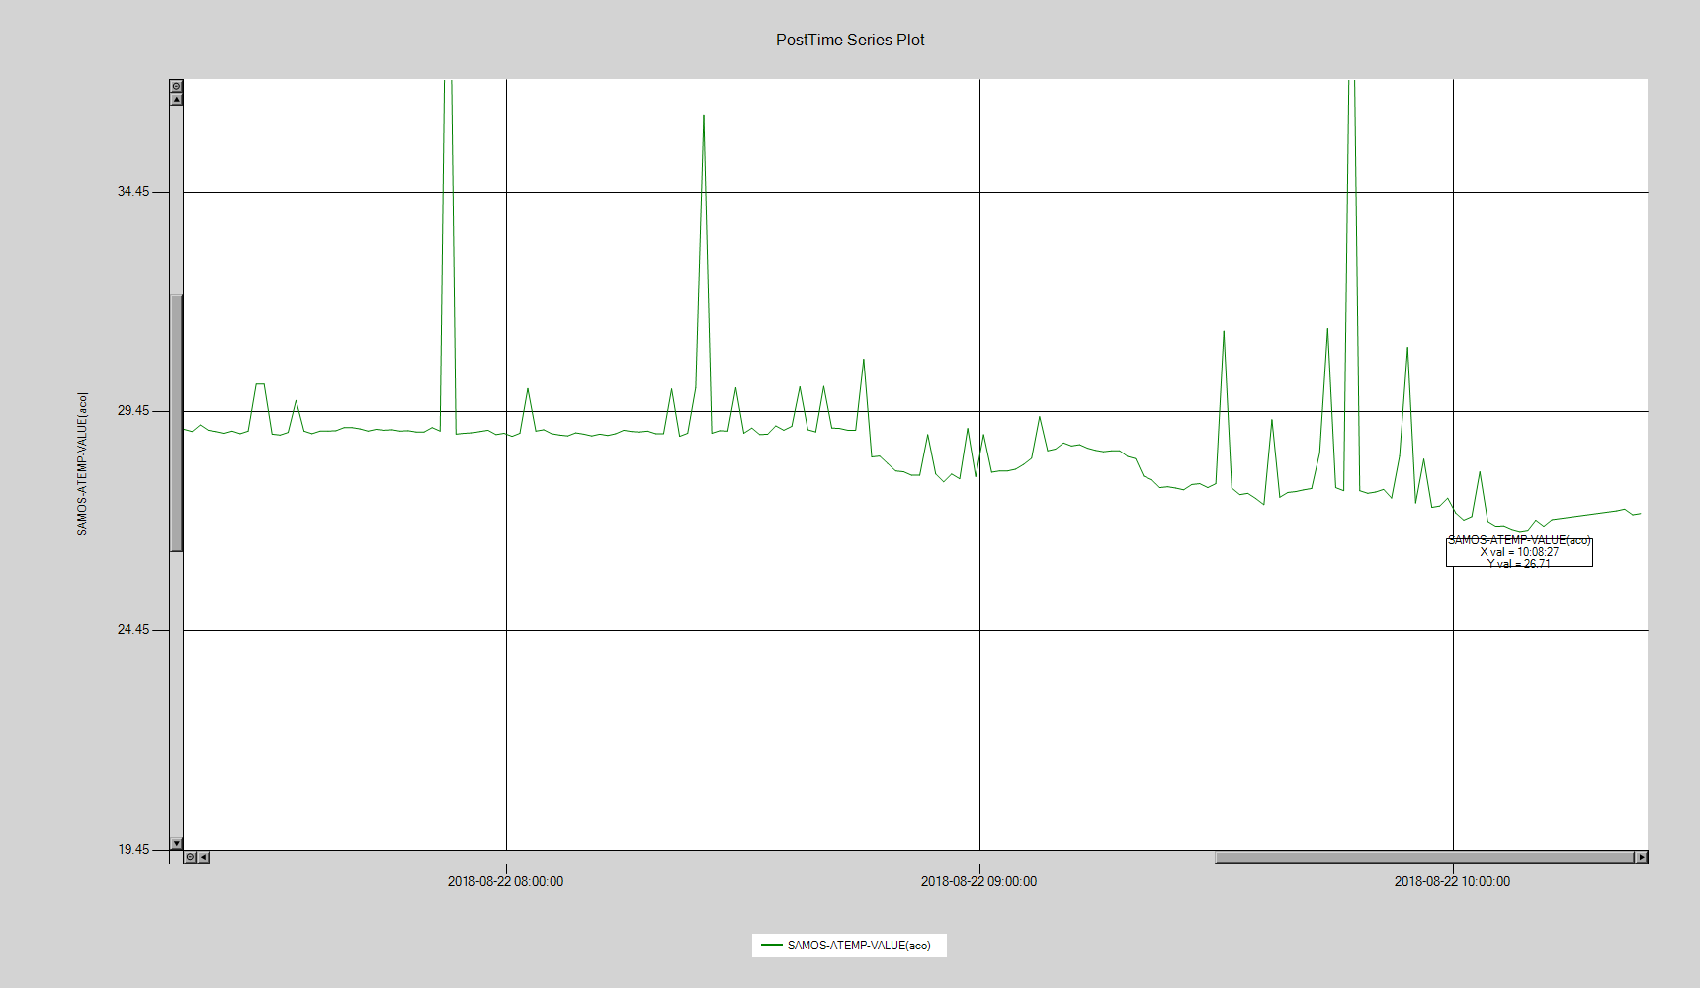

Slide 53
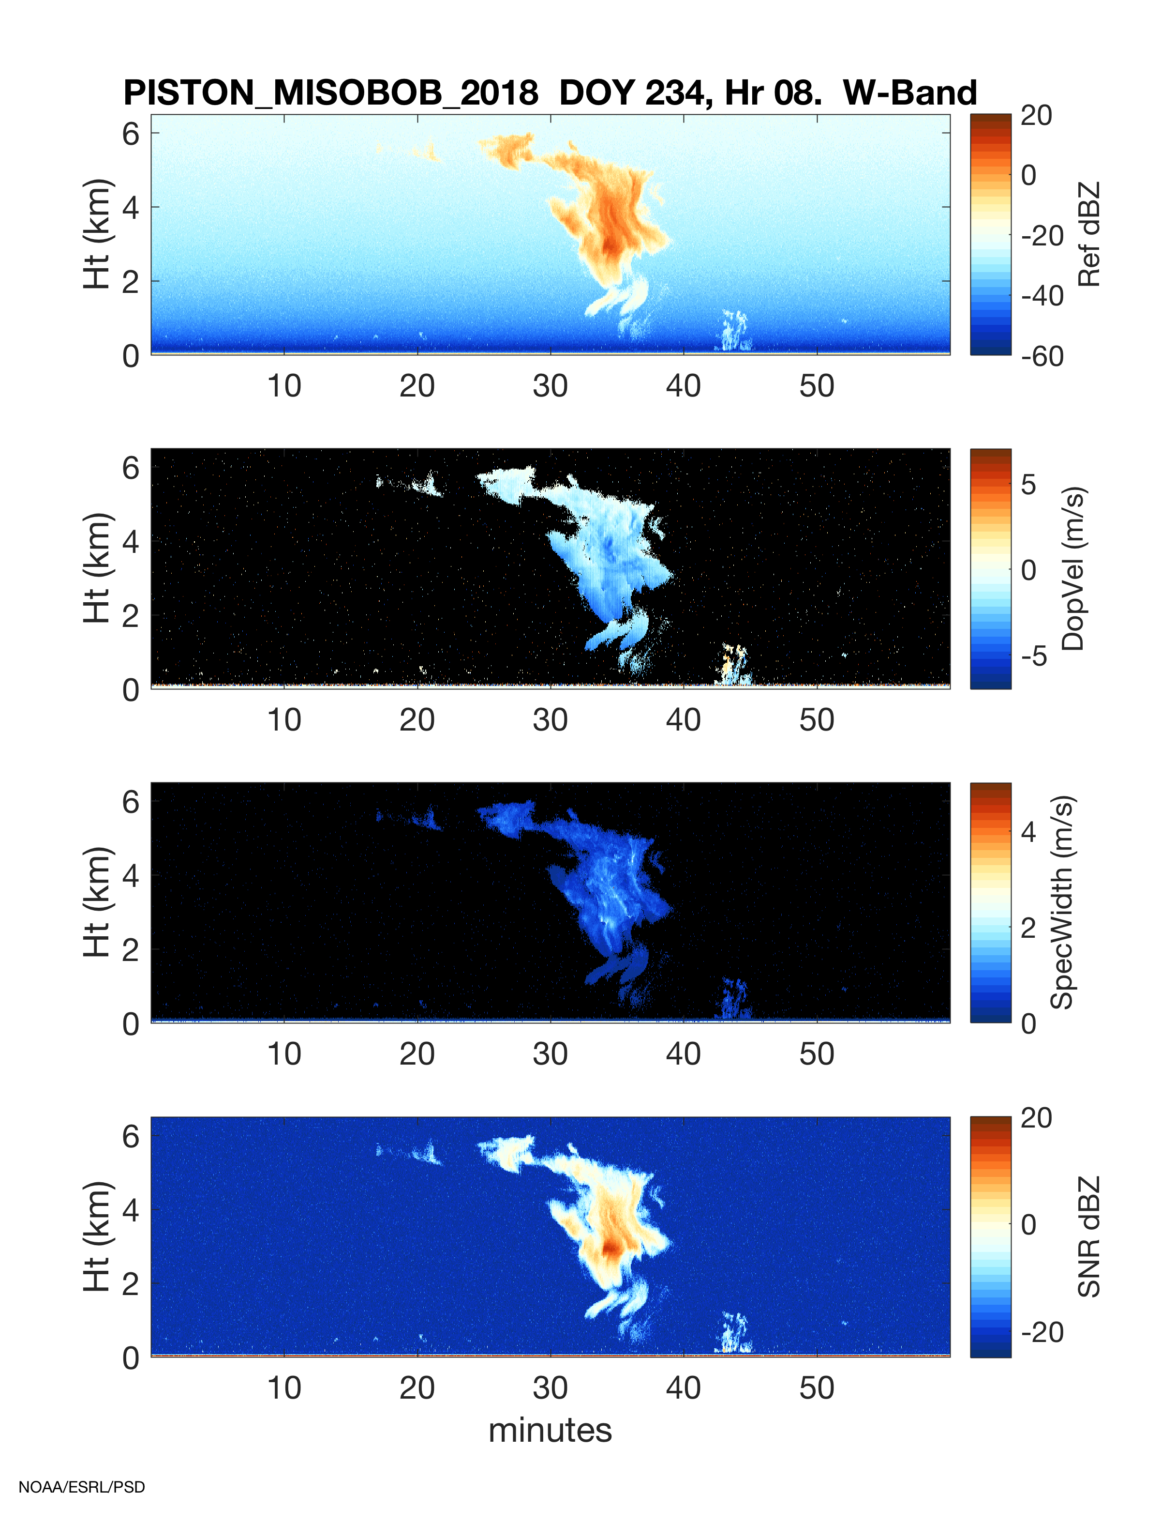

Slide 54
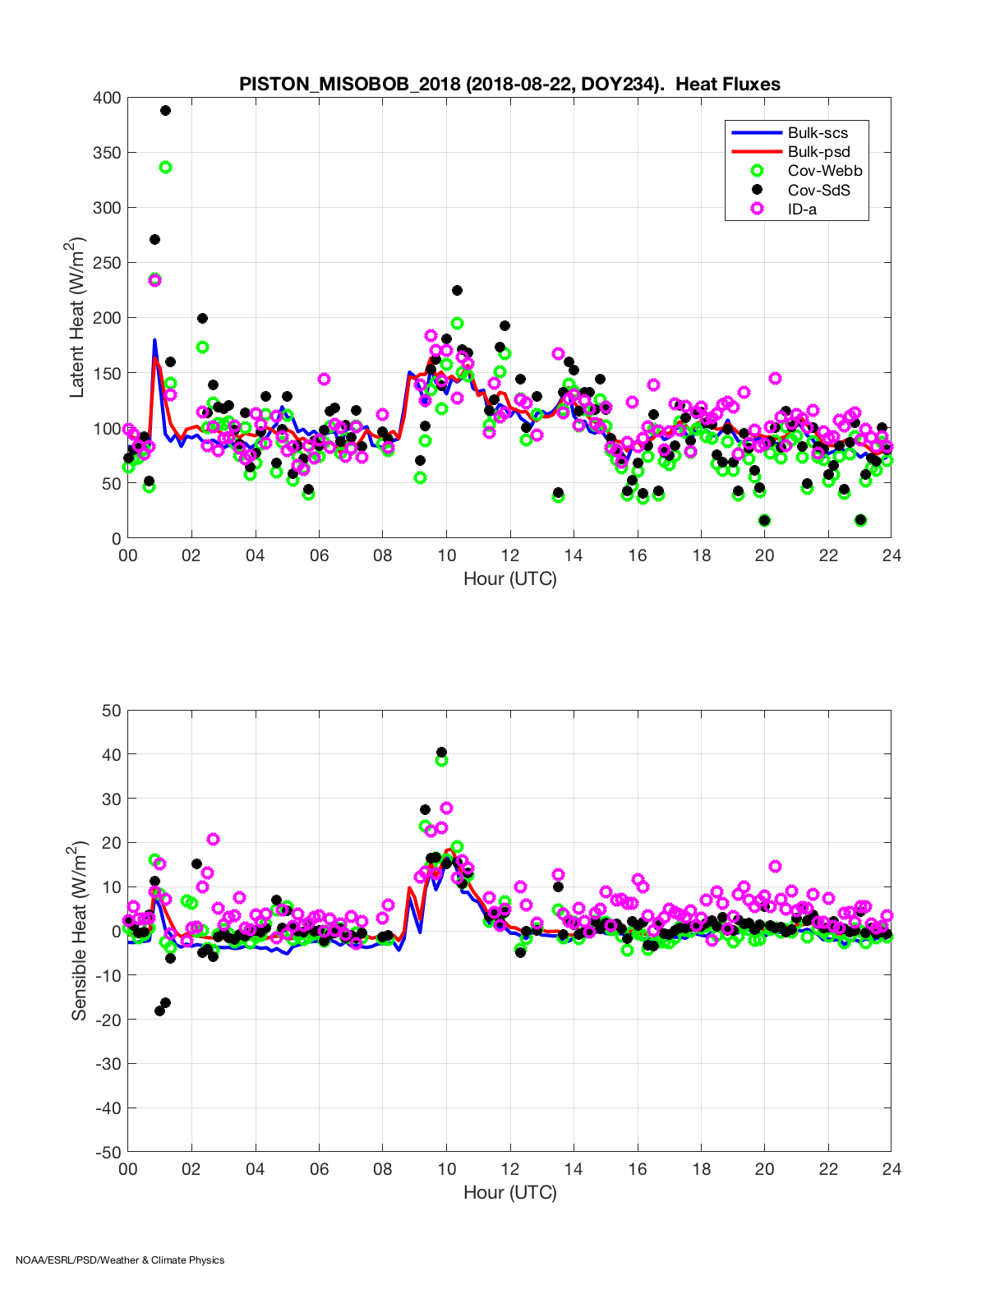

Slide 55
High ZDR in young convection

Slide 56
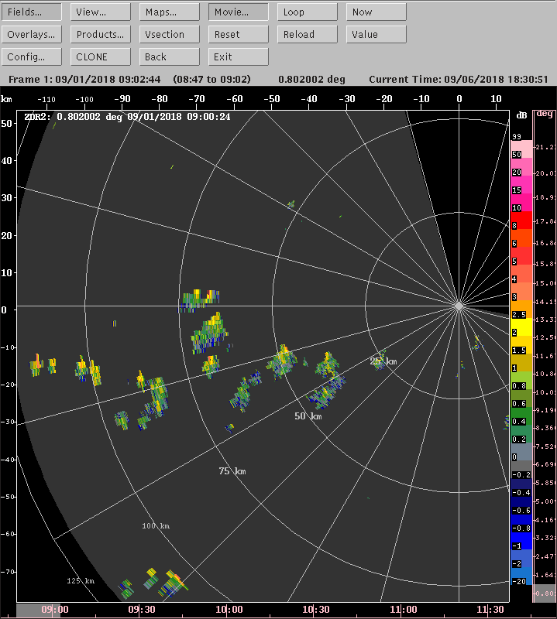
High Z_{DR} in young isolated cells. What is going on?

Slide 57
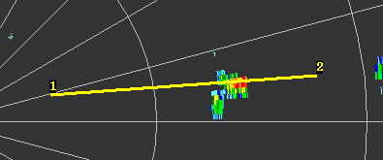
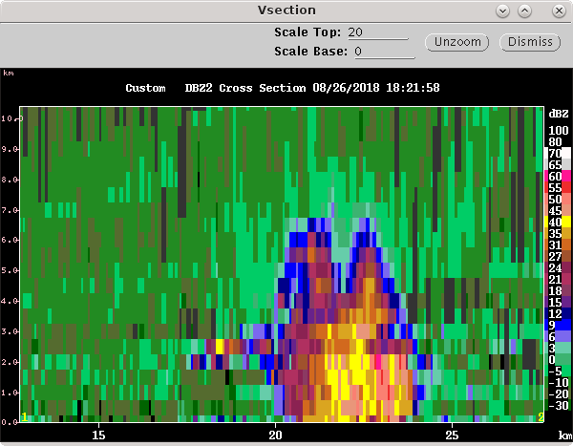
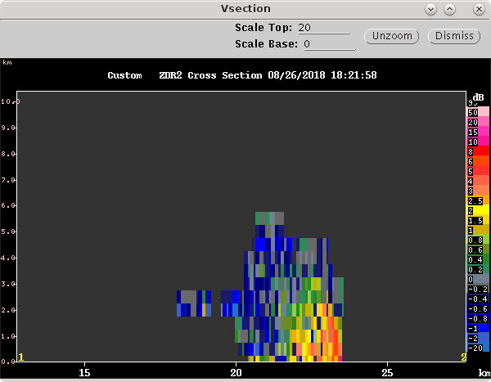
Plan view
Reflectivity
Differential reflectivity

Slide 58
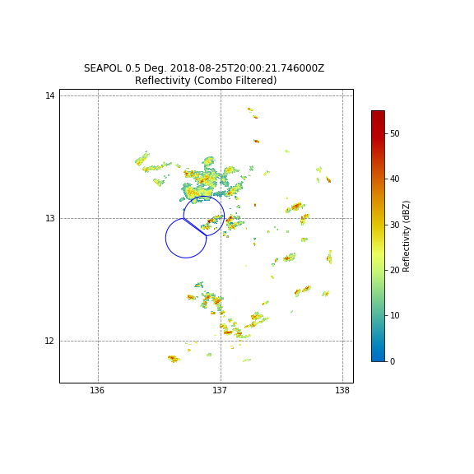

Slide 59
“Aggregation” of Convection

Slide 60
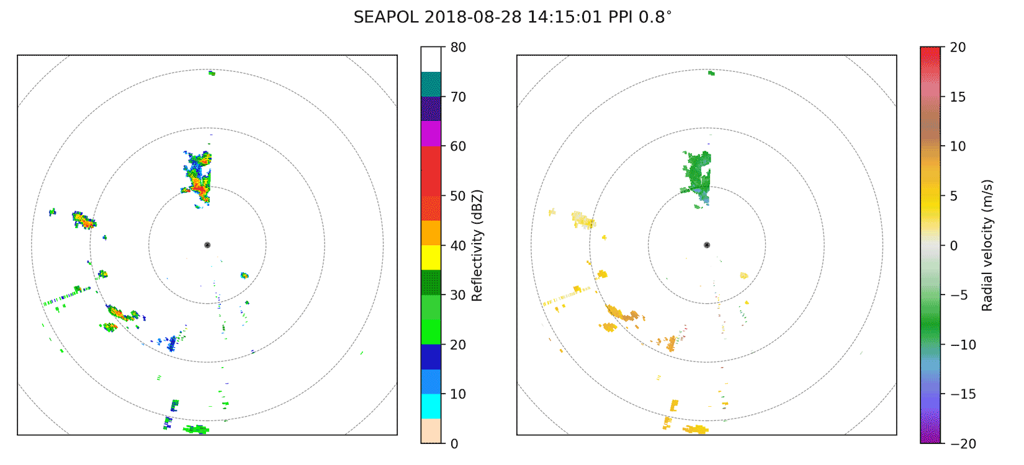

Slide 61
How does convection end up in an ”aggregated” state?
“Self-aggregation”
“Upscale growth?”

Slide 62
Summary
Ship-based field campaign with focuses on
Multi-scale variability in convection
Air-sea interaction
Precipitation of inflow to typhoons
A few big topics emerged (non-exhaustive list from just my thoughts on the atmospheric side!):
What happened to intraseaonal variability during PISTON (i.e. why did it not occur?)
What modes of variability were present?
Why no rain suppressed periods when atmosphere was so moist?
Kinematic and microphysical structure of moist convection
Many observations of cold pools/other mesoscale organization

Slide 63
End

